Slide 1
World Religions The Story of Us
What does it mean to be HUMAN???

Slide 2
What do Religions all have in common?
We all have a desire to be united with something bigger than ourselves, something outside us, something beyond us or even something deep inside of ourselves.
This is known as the “Ultimate Reality”, just another word for GOD!!!
God has been understood from different cultures and at different times.
In attempting to understand God, we are attempting to better understand ourselves.

Slide 3
Religions Around the World
Christianity 2 billion
Islam 1.3 billion
Hinduism 900 million
Atheist 850 million
Buddhism 360 million
Chinese Traditional religion 225 million
Primal indigenous (Tribal Religions)150 million
Sikhism 23 million
Judaism 14 million

Slide 4
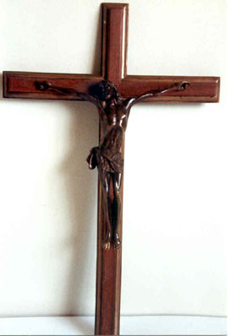
Christianity - The Cross

Slide 5
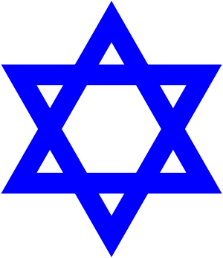
Judaism – The Star of David

Slide 6
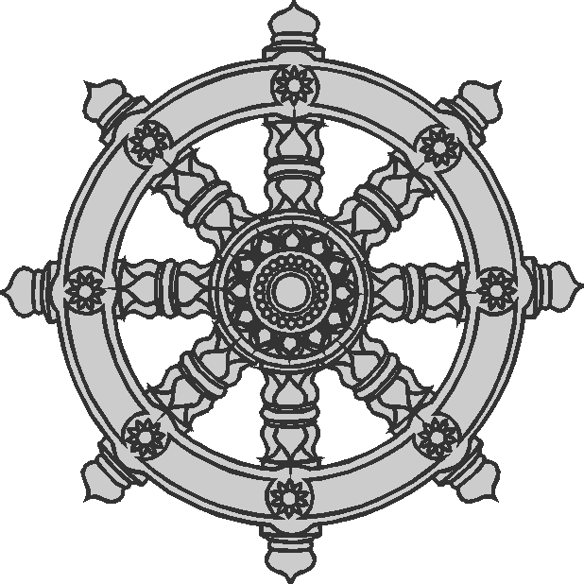
Buddhism – The wheel of Life

Slide 7
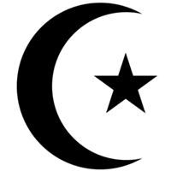
Islam – The Crescent Moon

Slide 8
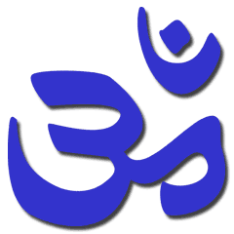
Hundism – Symbol of Omkar

Slide 9
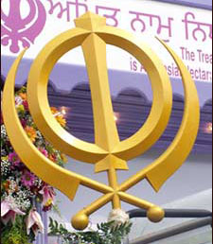
Sikhism - The Khanda

Slide 10
Christianity Traditional Dress

Slide 11
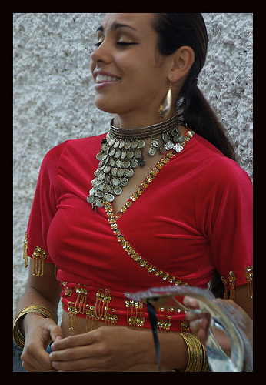
Hindu Traditional Dress

Slide 12
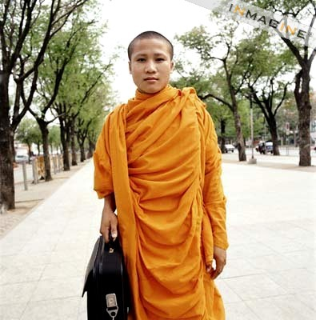
Buddhist Traditional Dress

Slide 13
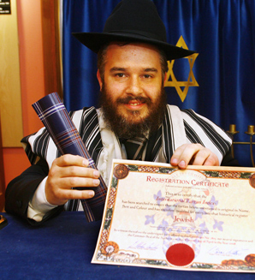
Jewish Traditional Dress

Slide 14
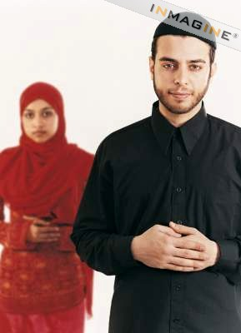
Islam Traditional Dress

Slide 15
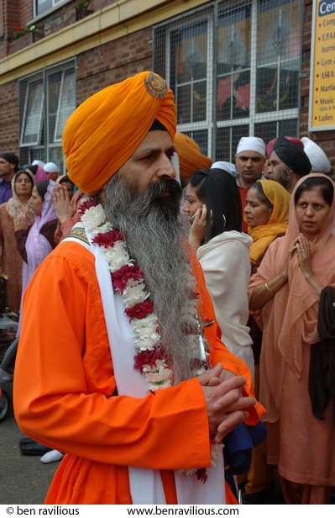
Sikhism Traditional Dress

Slide 16
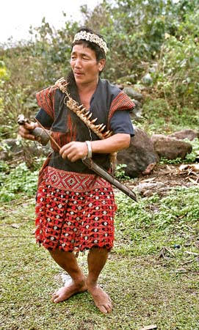
Tribal Religions Traditional Dress

Slide 17
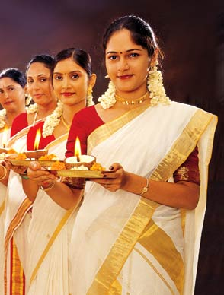
Are we all so different?

Slide 18
Christianity
Origins
God promised to send a MESSIAH. The Messiah was Jesus Christ who they believed to be the son of God.
Jesus spoke in parables or moral stories drawn from situations in life.
Jesus was arrested for showing contempt for God by attributing God like qualities to that which is not God.
Jesus was crucified and 3 days later was resurrected.
The resurrected Jesus visited his apostles and commissioned them to spread the word of his teachings.
40 days after his resurrection, Jesus ascended to Heaven.

Slide 19
Christianity cont...
Beliefs
Christian belief in god is derived directly from Judaism.
Both religions agree that there is one God who is an all good provider for the universe and all that fills it.
God is viewed as a supreme being who rules all creation but is also seen as a personal God by individuals through prayer.
While there may seem to be 3 different gods in Christianty – the Father, the Son and the Holy Ghost – they are all bound together as one God in the Holy Trinity.
Christians believe Jesus was human and that he suffered in order to accomplish the forgiveness of sin and human salvation.

Slide 20
Judiasm
Origins
According to scriptures, Abraham was instructed by God to move to a special land to raise a nation. This led to the idea that the Jews represent God’s chosen people and that Israel was the established promised land.
These 2 ideas are the foundation of the covenant (agreement) that god made with Abraham. This covenant is the key to the Jewish Faith.

Slide 21
Judiasm cont...
Beliefs
Jewish beliefs centres on the idea of the oneness of God and the compassion God shares with creation in the form of the covenant.
Nothing happens without god, therefore humanity has an obligation to worship God.
A Jew is a person who is either born Jewish or converts to Judaism. If the child’s mother is Jewish then the child is Jewish.
The act of performing a good deed is called a Mitzvah. This is a commandment from God that gives people direction on how to live ethically while honouring god.

Slide 22
Buddhism
Origins
Buddhism was founded 2500 years ago in India.
Queen Maya conceived her son when Siddartha descended from Heaven and entered his mother’s womb in the form of a baby elephant – a symbol of purity.
Siddartha was to eventually become Budda.
Siddartha began to teach the ways of Buddhism.

Slide 23
Buddhism cont...
Beliefs
Existence: The idea that the world is in constant flux and nothing remains the same. All human and animals experience suffering & we cannot point to any 1 thing about ourselves that we can call self.
Rules of conduct: Abstain from harming others, stealing, improper sexual conduct, false speech, alcohol & drugs, eating after noon, looking at dancing, singing & drama, use of perfumes, comfortable beds or accepting gold or silver.
Noble truths: To live is to suffer and the goal for all Buddhists is to end suffering and to end suffering you must take the noble path.

Slide 24
Islam
Origins
Muslims believe the central figure in the emergence of the religion of Islam is the Prophet Muhammad. He received directions from God through the Angel Gabriel.
The people of Arabia believed in polytheism (the belief in more than one god). Polytheism was expressed in the practice of idolatry, the worship of different objects usually in the form of sculptures and pictures each representing a specific spiritual quality.
Muhammad led Arabia away from idolatry and into the belief in the oneness of God.

Slide 25
Islam cont...
Beliefs
For Muslims, beliefs are a purely personal affair. Muslims are not called upon to compel anyone to believe what they believe.
There is no god but God and Muhammad is the Messenger of God.
Muslims believe God’s proper name is Allah. The word Islam means Submission to God or Surrender to God’s will.
Muslims believe that every person has a soul that lives for one lifetime and upon death the soul moves on to an afterlife.

Slide 26
Hinduism
Origins
Hinduism was not founded by a particular individual.
Hindu is universally accepted as the word that refers to the religion of India but the people of India do not consider their religion to be called Hinduism.
Foreigners who settled in India left their own mark on Hinduism as the religion assimilated many of their customs.
Some describe Hinduism as Polytheistic (a religion with many gods)
Brahman is an entity without form. It is the soul of the universe from which all things begin and end. Brahman is the creator of the universe.

Slide 27
Hinduism cont...
Beliefs
Hindus believe that the soul does not die along with the body but enters another body to carry on its existence. This endless cycle of rebirth is called Samsara.
The goal is to achieve Moksha or liberation from the endless cycle of rebirths and to unite the Atman (the human soul) with Brahman.
A person’s actions determines the form that individual will take when he/she is reborn. This is known as Karma.
Hindus refer to their religion as Dharma, which means code of moral and righteous duty.

Slide 28
Sikhism
Origins
Sikhism is the fifth largest religion in the world. It is also one of the newest and has only been in existence for about 500 hundred years.
It originated with the teachings of Guru Nanak who rejected the philosophies of the Hindu society that he grew up in.
Refusing to participate in Hindu rites, he argued against the caste system and preached equality of mankind.
Sikhism teaches the existence of one God. Guru Nanak taught that the creator and creation are inseparable in the way that an ocean is made up of its individual drops.

Slide 29
Sikhism cont...
Beliefs
The Sikh notion of a saint or prophet is called a guru, meaning one who can offer salvation, and deliver a soul from darkness, into light.
The Guru Granth is the eternal Guru of the Sikhs and may never be replaced by a human being.
God is the Creator of the Universe. All human beings are equal. After a person dies, his soul is born again in another body, human or animal. Sikhs are a peace loving people and stand for Truth and Justice.
Sikh have 4 basic principals for living: Meditation, Work, Charity Donations and Service to Humanity and God.

Slide 30
Other World Religions
African Traditional & Diasporic
Juche
Spiritism
Baha'i
Jainism
Shinto
Cao Dai

Slide 31
Other World Religions cont...
Zoroastrianism
Tenrikyo
Neo-Paganism
Unitarian-Universalism
Rastafarianism
Scientology

Slide 32
In attempting to understand God, we are attempting to better understand ourselves.
What do YOU think???

